Slide 1
Tuning Data Warehouse

Slide 2

Key Benefits
“tu(r)ning today’s data into today’s decisions”

Slide 3

Introduction
Tuning DW is difficult than OLTP
Tune DW with clear understanding of business
DW Changes as profiles , data usage change

Slide 4
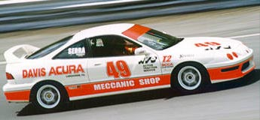



Key Principles
Speed
Analyze Today's business needs and not the past
Complementary
Maximize existing technological investments
Simple
Ease of implementation and maintenance

Slide 5
Tuning Guidelines
Do not tune just for the sake of tuning
Consider the whole system
Check for hw and sw problems

Slide 6
performance
Performance is the way a computer system behaves given a particular work load
It is affected by
    The resources available
    How well those resource are used and shared

Slide 7
Performance Improvement
Strategic Performance Improvements
  Change / Enhance Hardware platform
  Off load data in data warehouse to data mart
Tactical Performance
  End user education

Slide 8
Performance Imp. In Oracle8i
set the CURSOR_SPACE_FOR_TIME parameter to TRUE
  shared SQL won’t deallocated associated with shared pool
  SQL statement have been closed
  performance improvement on execution calls are done
  CURSOR_SPACE_FOR_TIME set to FALSE
  Performance will get worse
  Shared SQL allocated

Slide 9
Tune the database for sorting in Oracle 8i
1.Query the MEM_SORT view to determine the number of sorts performed in memory and on disk.
2.If fewer sorts on disk are desired, increase the SORT_AREA_SIZE parameter in the appropriate INIT.ORA file.

Slide 10
(Contd…)
3.Stop and restart the database.
4.Allow the database to run at least a full business day for accurate sorting statistics to be gathered.
5.Repeat this procedure until the number of sorts performed on disk is acceptable.

Slide 11
Example of Tuning the Sort Space
The following SQL*Plus session shows the MEM_SORT view being checked by the SYSTEM user:
SELECT NAME,VALUE FROM MEM_SORT WHERE NAME LIKE 'sort%';
NAME | VALUE
sorts (memory) | 2922
sorts (disk) | 97
sorts (rows) | 32693

Slide 12
(contd….)
The number of sorts performed on disk (97) is a bit high.
The following line appears in the relevant INIT.ORA file: sort_area_size = 65536
The first test to reduce disk sorts will increase the sort_area_size parameter to 128KB
    97 sorts were being performed on disk
    Parameter increased to 128k
    sort_area_size = 65536

Slide 13
(contd…)
After the database was stopped and restarted (to activate the new parameter), one full business day elapsed and the MEM_SORT view was queried again.
These are the results:
By increasing the sort_area_size parameter to 128KB, the number of disk sorts has been lowered to an acceptable level.
NAME | VALUE
sorts (memory) | 3661
sorts (disk) | 3
sorts (rows) | 34014

Slide 14
Maximizing Redo Log Performance in oracle8i
Information about every change Oracle makes to a database's physical file components.
Minimize the amount of time

Slide 15
Sizing Redo Logs to Allow Checkpoint Completion
Check point can affect system performance
The system should ideally be tuned such that a checkpoint occurs only during a log switch.
checkpoints can finish well before a log switch is necessary

Slide 16
Example of Checking for Checkpoint Completion
The MEM_SORT view is queried for the background checkpoint statistics by the SYSTEM user in SQL*Plus.
The example session follows:
select name,value from MEM_SORT where name like 'background checkpoint%';
NAME | VALUE
background checkpoints started | 4521
background checkpoints completed | 4520

Slide 17
Identifying the problem
1.The two background checkpoint statistics vary by only 1.
2.This indicates that checkpoints are finishing before a log switch is forced.
3.If the background checkpoints completed were 3,788, we would have to increase the size of the redo log files until the two statistics varied by only 1.

Slide 18
Types of performance
OLTP performance
Analytical system performance
Data performance
Assessing performance

Slide 19
Background on Data Performance
OLTP Performance
Analytical System Performance
2-3 Sec consistently
30 Sec to 5 min to 24 Hrs to weekly / Monthly
Minimal & Uniform
Access 10 - 100 rows
Non – Uniform
Access 000’s to millions of rows of data
Decisions – Immediate & finite
Decisions more sweeping with Long term effect

Slide 20


Data Performance Today
How does data performance affect user analysis?
  john and Sarah have different data performances resulting in different working behaviours.

Slide 21
Data Performance Impacts Everyone!
Business Climate is changing the rules
  Increase in data (CRM, ERP, OLTP, Web)
  Change in mindset on Business Intelligence
  Ability to be Pro-active(Companies are going to have to be more proactive about environmental management.)
  Impacts Everyone
  CEO, MD’s
  Sales / Marketing
  Database Administrators
  Business Intelligence Consultants

Slide 22

Assessing Performance
Objective Measures
  Average Query response time.
  Scan Rates.
  I/O throughput rates.
  Time Used per Query.
  Memory usage per Process.
The above measures should be specified in SLA.
Query
Relational
Database
Results

Slide 23
SLA (Service Level Agreement)
  Essential part of
    Design process of DW
    Design of Backup strategy
    Partitioning of fact data

Slide 24
Aspects of SLA
Basis on aspects SLA can be divided into two categories
    User requirements
    System requirements

Slide 25
User requirements
User Online access
e.g.Hours of work.
User expected response time
  Maximum acceptable time
  Average response times

Slide 26
UR contd…
Specify external behavior of system
No technical details
e.g invoicing to calculate sales or central tax
Ensure the requirements of every group of users
Ask users what they need, not what they want

Slide 27
System requirement
System availability
Network access and availability
  Average time
  Priority of access to network
  Priority of access to backup/HW

Slide 28
EXPECTATIONS
When assessing performance it is essential that you have realistic expectations
The size and complexity of a data warehouse and ad hoc nature of the queries,make expectations difficult to set

Slide 29
TUNING CAN BE ACHIEVED
To throw hardware at the problem
Scaling of queries can be addressed by HW as data size increases
Using more disks will spread the I/O load

Slide 30
SOLUTIONS
Hardware guarantees
    I/O throughput
    Scan rates
    Processing capacity
Software performance guarantees
    More difficult to get

Slide 31
TUNING DATA LOAD

Slide 32
Why need tuning data load?
Speeds up ad hoc and fixed queries
Optimize hardware performance
Increase efficiency of loading process
Ensure data is consistent
Avoid duplication of data
Reduce operational cost
Avoid bottlenecking

Slide 33
Before Extract Data
Extract data in Consistent state
Use temporary databases for initial extraction
Break or add fields
Convert to required format

Slide 34
Data flow through the data warehouse
Data Sources
Warehouse server
ORACLE
Metadata
Extraction
Data
Warehouse
Metadata
Extraction
Utilities
DB2
Detail
Records
MSACCESS

Slide 35
Tuning Processor
Before loading we must tune the processor
E.g consider simple c program
main()
{
while(1) { }
}
Consumes 100% of the CPU

Slide 36
Data load
Entry point
First opportunity to improve performance
Data loading software
    Checks to be bypassed
Using DML operations
    Parallel insert
    Parallel delete,update
Overnight processing

Slide 37
Schedule Manager
Bank Timings : 8 a.m. – 5 p.m.
Schedule
Work | Time
Data load | 5 p.m. - 9 p.m.
Data transformation | 9 p.m. - 10 p.m.
Index creation | 10 p.m. - 12 a.m.
Aggregation creation | 12 a.m. - 3 a.m.
Backup | 3 a.m. - 5 a.m.

Slide 38
Warehouse Manager in Tuning
Monitors performance
maintains query history
  Automatically creates new aggregation and indexes
Ultimate goal to get data load into DW

Slide 39
DL Contd..,
Different methods of getting data
  Loading from files
  SQL statements
  3GL programs
  Copy management tools

Slide 40
DW Workload
Broad
  Queries over ranges of values
Deep
  Queries that require precise information
Dynamic (vs. Static)
  Queries that require up-to-date information

Slide 41
Loading from Flat Files
Two types
    Comma-Delimited File
    Tab-Delimited files
Comma-Delimited File
    comma separates each field
    E.g. consider a opinion.txt file
  media group NDA+ congress others
Sahara 263-278,92-102,171,-181
Star 263-275,174-186,86-98
Zee 249,117-120,176-180

Slide 42
Comma-Delimited File
Query for loading delimited file to opinion table
LOAD DATA INFILE ‘OPINION.TXT' INTO TABLE OPINION_POLL FIELDS TERMINATED BY ',' OPTIONALLY ENCLOSED BY '"' (NDA+,congress,others)

Slide 43
Contd..,
Tab-Delimited File
  tab space separates each field
  E.g.
  media group NDA+ congress others
Sahara 263-278 92-102 171,-181
star 263-275 174-186 86-98
zee 249 117-120 176-180

Slide 44
Load with Conditional Checking
The following query checks the condition while loading using when clause
LOAD DATA INFILE 'STATS.TXT' INTO TABLE POLL_STATISTICS WHEN YEAR = "1997" FIELDS TERMINATED BY ',' OPTIONALLY ENCLOSED BY '"' (media,year,polling_average)

Slide 45
Parallel Load
Requires
  Multiple processor
pros
  Reduces the overall time
  Increase CPU operation
E.g.,Create and populate
  CREATE TABLE new_table PARALLEL NOLOGGING
AS SELECT col1,col2, col3 FROM old_table;

Slide 46
Direct path loading
Avoid large no. of insert operation
Available in SQL *loader
Which creates preformatted data block
To use DP option
DIRECT=TRUE
Improve load performance
    Use unrecoverable pattern
    Not generate redo log files
    faster than conventional methods

Slide 47
Parallel DPL
Divided DL among multiple processes
Divided 20 million records text files into two parts such as data1.txt and data2.txt(load1.ctl & load2.ctl)
SQL statement
SQLLOAD USERID=system/manager CONTROL=LOAD1.CTL PARALLEL=TRUE DIRECT=TRUE
SQLLOAD USERID=system/manager CONTROL=LOAD2.CTL PARALLEL=TRUE DIRECT=TRUE

Slide 48
Steps in Tuning
Preallocate space for the table
Allocate sufficient memory
Creating DBWR process
Remove any unnecessary
  Triggers
  Constraints
Remove any indexes on the tables

Slide 49
Tuning data load involves
Perform consistency and integrity checks
Creating indexes and partition
Creating business views
Denormalization if appropriate
Aggregation and Summary tables

Slide 50
views
Combine large no. of fact tables attributes
Speed up queries performance
Cons
    Duplication of data
    Meaningful period of time
    Waste of space

Slide 51
Maintaining of indexes
Costly part
Depend on the size
Number of indexes on that partition
Optimizing the data load
    Drop the all indexes while while data being loaded
    Recreate the indexes

Slide 52
Contd…
Cons
    Drop and recreate indexes for large datum
    Update indexes after each row added
pros
    Scanning the entire data
    Extracted and sorted quickly
    Parallel index build

Slide 53
Integrity checks
Occurs before the data arrives at DW
Minimize checks in DW
Make sure data is consistent within
        itself
        same source
        Other source systems
        Information already in DW

Slide 54
contd..
Checks,transformations increase CPU time and reduce DL time
      Direct load technique
      Parallelism
      Multiple process used to speed the load
Multiple loads introduces bottlenecks
      Split load data into multiple files
      Spread source data to multiple disks

Slide 55
summary
Due to tuning the data load
  Increase the performance of queries access time
  Decrease the data load time
  Data in DW is consistent
  Maximize utilization of CPU time

Slide 56
Tuning Queries
Ad hoc Queries
Queries
Fixed Queries

Slide 57
QUERY PERFORMANCE
Unexpected long lasting queries can be caused by
    Slow network connection
    Slow running queries
    Lack of useful statistics
    Out of date statistics
    Lack of useful indexes
    Lack of useful data striping

Slide 58
HOW TO IMPROVE
Use the following checklist
    Is it due to network connection?
    Is it related to queries?
    Was the query optimized with useful statistics?
    Are the query statistics up to date?
    Are suitable indexes?

Slide 59
TYPES OF QUERIES
Two types of queries
Fixed queries
    Clearly defined and well understood
Adhoc queries
    Unpredictable in quantity and frequency

Slide 60
WHY TUNING NEEDED?
Both types need to be tuned,
    To improve the query performance
    To reduce the elapsed time
    To reduce the number of resources used by the queries
    To produce the expected output efficiently

Slide 61
EXAMPLE (FIXED QUERY)
Selecting student details from AIMS is a good example.
SQL> Select name, address, course, department from student .

Slide 62
TUNING FIXED QUERIES
Similar to traditional tuning of relational database
Have predictable resource requirements
Stores the best execution plan for each queries

Slide 63
METHODS FOR TUNING
New aggregations or extra indexes to dimension data, such as
    B-tree indexes
    Bit-mapped indexes
Different storage mechanisms, such as
    Clustered tables
    Hash clusters
    Index-only tables

Slide 64
B-TREE INDEX
Uses levels of branch blocks, each level containing pointers to the next lower level
The number of blocks, or levels, in such a chain defines the height of a B-tree.
The larger the height, the greater the number of blocks, the slower the index.

Slide 65
SYNTAX FOR CREATING B-TREE INDEX
01: CREATE [UNIQUE] INDEX[index_schema.]index_name
02: ON [table_schema.]table_name (
03: column_name [ASC][DESC] [,...] )
04: [parallel_clause]
05: [NO[LOGGING]]
06: [TABLESPACE tablespace_name]
07: [NOSORT]
08: [storage_clause]
09: [space_utilization_clause]

Slide 66
BITMAP INDEX
It is particularly suited to large tables and to columns
Very efficient when two or more conditions have to be met by a query
Less efficient than B-tree index when indexed columns are updated

Slide 67
BITMAP INDEX(contd)
They're even efficient when two or more values are requested from a column
They're very efficient at finding rows based on multiple column queries, such as
  WHERE region = 'West' AND week = 43 AND salesman = 202 AND product = 1497 AND color = 'RED'

Slide 68
CLUSTERED TABLES
Optimal method for storing table data
Made up of group of tables that share same data blocks
Disk I/O is reduced
Access time improves for joins of clustered joins

Slide 69
SYNTAX FOR CREATING CLUSTER
CREATE CLUSTER emp_dept(deptno NUMBER(3))
PCTUSED 80
PCTUSED 5
SIZE 600
TABLESPACE users
STORAGE(INITIAL 200K NEXT 300K
MINEXTENTS 2 MAXEXTENTS 20
PCTINCREASE 33);

Slide 70
SYNTAX FOR CREATING CLUSTERED TABLES
CREATE TABLE dept(
deptno NUMBER(3) PRIMARY KEY,…)
CLUSTER emp_dept(deptno);
CREATE TABLE emp(
empno NUMBER(5) PRIMARY KEY,
ename VARCHAR2(15) NOT NULL,
deptno NUMBER(3) REFERENCES dept)
CLUSTER emp_dept(deptno);

Slide 71
HASH CLUSTERS
Optimal way for storing table
Optimal way to improve performance of data retrieval
To use hashing, create a hash cluster & load tables into it
Oracle stores & retrieves rows of a table in a hash cluster w.r.t the result of a hash function

Slide 72
SYNTAX FOR CREATING HASH CLUSTER
CREATE CLUSTER trial_cluster(trialno NUMBER(5,0))
PCTUSED 80
PCTFREE 5
TABLESPACE users
STORAGE(INITIAL 250K NEXT 50K
MINEXTENTS 1 MAXEXTENTS 3
PCTINCREASE 0)

Slide 73
HASH CLUSTERS(contd)
HASH IS trialno HASH KEYS 150;
CREATE TABLE trial(
trialno NUMBER(5,0) PRIMARY KEY,
………………………………………..)
CLUSTER trial_cluster(trialno);

Slide 74
INDEX ONLY TABLES
Index on every column of a table
Oracle uses a special access method called index fast full scan
Index can be queried without actually touching the data
Multiblock read facility allows oracle to very quickly to scan index blocks in linear order

Slide 75
SYNTAX TO CREATE AN IOT
CREATE TABLE emp_iot(
emp_id NUMBER,
ename VARCHAR2(20),
deptno NUMBER,
CONSTRAINT pk_emp_iot_index PRIMARY KEY(emp_id))
ORGANISATION index
TABLESPACE spc_demo_ts_01
PCTHRESHOLD 20 INCLUDING ename;

Slide 76
AD HOC Queries

Slide 77
FIXED Queries vs. AD HOC Queries
Predictable resources
Planned
Unpredictable resources
Unplanned

Slide 78
Example (Ad hoc query)
name | constituency | year | result
Ram | Chennai(South) | 1991 | won
John | Chennai(North) | 1991 | lost
Abdul | Vellore | 1991 | won
Ram | Chennai(South) | 1999 | won
John | Chennai(North) | 1999 | lost
Ram | Chennai(South) | 2004 | won
Sathya | Dharmapuri | 2004 | lost

Slide 79
Query
E.g.,
  Selecting candidate details from ELECTION_RESULT who has continuously won the election for certain period.
  Select name,constituency from ELECTION_RESULT where constituency=‘Chennai(south)’ and year between 1991 to 2001 and result=‘won’.

Slide 80
Contd.,
Selecting student details from AIMS who is from Madurai and with a CGPA less than 8
Select name, CGPA, city, course, department from student where city=‘Madurai’ and CGPA> 8.

Slide 81
Query Manager in Tuning
Software interface between users and data
  Responsibility
    Query Monitoring (Every query must be run via this or to be noted)
    As USERS and DW grows larger, DW success depends on managing queries
    Key point for success is tuning to ad hoc environment

Slide 82
Query Manager
User Access to data
Voter id | name | age | income
2001 | raj | 23 | 3000
2002 | ram | 34 | 4000
2003 | sam | 25 | 5500
2004 | tim | 26 | 6500
2005 | jim | 27 | 8000
2006 | arun | 27 | 9000
2007 | adam | 29 | 6000
õÿ ô À à _x0014_ õÿ ô À à _x0014_ _x0001_ À à _x0014_ _x0001_ + õÿ ø À à _x0014_ _x0001_ ) õÿ ø À à _x0014_ _x0001_ , õÿ ø À à _x0014_ _x0001_ * õÿ ø À à _x0014_ _x0001_ õÿ ø À “_x0002__x0004_ _x0010_€_x0003_ÿ“_x0002__x0004_ _x0011_€_x0006_ÿ“_x0002__x0004_ _x0012_€_x0004_ÿ“_x0002__x0004_ _x0013_€_x0007_ÿ“_x0002__x0004_ € ÿ“_x0002__x0004_ _x0014_€_x0005_ÿ`_x0001__x0002_ … _x000e_ _x0008__x0006_ _x0006_ Sheet1… _x000e_ û _x0006_ Sheet2… _x000e_ _x0002_
_x0006_ Sheet3Œ _x0004_ _x0001_ _x0001_ Á_x0001__x0008_ Á_x0001_ T_x0001_ ü j _x0013_ _x000f_ _x0002_ id_x0004_ name_x0007_ balance_x0003_ age_x0008_ acc_type_x0003_ raj_x0003_ ram_x0003_ sam_x0003_ tim_x0003_ jim_x0004_ arun_x0004_ adam_x0002_ SB_x0002_ CA_x0002_ FDÿ _x0012_ _x0008_ Œ_x0005_ _x000c_ Å_x0005_ E _x0008__x0010_ _x0006__x0010_ F_x0018_Í_x0007_Á€ _x0006__x0002_
_x0002__x0014_ _x0008_ Ä_x0006_ ¬
_x0002_ _x0001_ _x000c_ _x0002_ d _x000f_ _x0002_ _x0001_ _x0011_ _x0002_ _x0010_ _x0008_ ü©ñÒMbP?_ _x0002_ _x0001_ *
Raw Data
Clear front end

Slide 83
Query Monitoring
Query statistics :
Query | Resources | Execution time (in sec) | User name
A | ELECTION_RESULT, VOTING | 20 | John
B | ELECTION_RESULT, VOTING | 10 | John
C | ELECTION_RESULT, CANDIDATE | 15 | David

Slide 84
QM Contd..,
User access control
    Controls user access
    Your query statistics will be less accurate
Scheduling
    Scheduling of ad hoc queries(using Queuing)
    Issue command to abort & requeue jobs
    Prediction tools present in some RDBMS

Slide 85
Query Scheduling
select cust_name from customer, loan Where customer.loan-number = loan.loan-number and branch_name = ‘Adyar’ and (branch_name, cust_name) in (select branch_name, cust_name From Fdepositor, account Where depositor.acc_number = account.acc_number)
  (Execution time = 20 seconds)
select cust_name from customer where cust_name not in (select cust_name from Fdepositor)
(Execution time = 10 seconds)
C. select customer.cust_name from customer, account, Fdepositor where customer.cust_name = depositor.cust_name and customer.acc_number = account.acc_number
  (Execution time = 15 seconds)

Slide 86
How to Tune Ad hoc Queries ?
Frequency,Quantity
Understanding user profiles
  Different queries against aggregation table
  How often?
  Frequently used indexes
This will help in
  Growth Predictions
  Capacity Planning
  Index/Aggregation should be used or deleted

Slide 87
Unpredictable
Predictable Queries
Batch queues
Monitor frequently used ad hoc queries
Identify similar ad hoc queries
    Create index/new aggregations
Precaution:
Ensure it does not affect other query performance

Slide 88
Batch Queues
Place it in Query queue
Executes when it reaches top of queue
When not to use Queuing Technique?
  Browsing summaries.
Alternate solution
  Control via Front end tool

Slide 89
Batch Queues Contd..,
How many queues ?
Depends on Number of Concurrent queries
May result in
  Monopolizing resources
  CPU Thrashing
When to use Multiple Queues?
  You have mix of small and large queries

Slide 90
Restrictions forced
Resource quota can be enforced and killed
Requeued on queue and run in large queue
Depends on sophistication of your query manager

Slide 91
Alternate to Multi Queue
Can we use Priority Queue?
    Users/Particular Queries have priority access
Disadvantage
    Query running in low priority with large resource and high priority query running at same time
Solution
    Move the query to head of queue
    Restart low priority query

Slide 92

ORACLE
SQL
TUNING

Slide 93
Common Areas of weakness
Selections involving arithmetic or string expressions
Selections involving complex sub queries
Selections involving NULL values

Slide 94
Solutions
K.I.S
Minimize the use of GROUP BY and HAVING
Use only one “query block” ,if possible
Avoid complex sub queries

Slide 95
Minimize the use of GROUP BY and HAVING
Select MAX(V.age)
From voters V
Group by V.cno
Having V.cno =102
Select MAX(V.age)
From voters V
Where V.cno =102
=

Slide 96
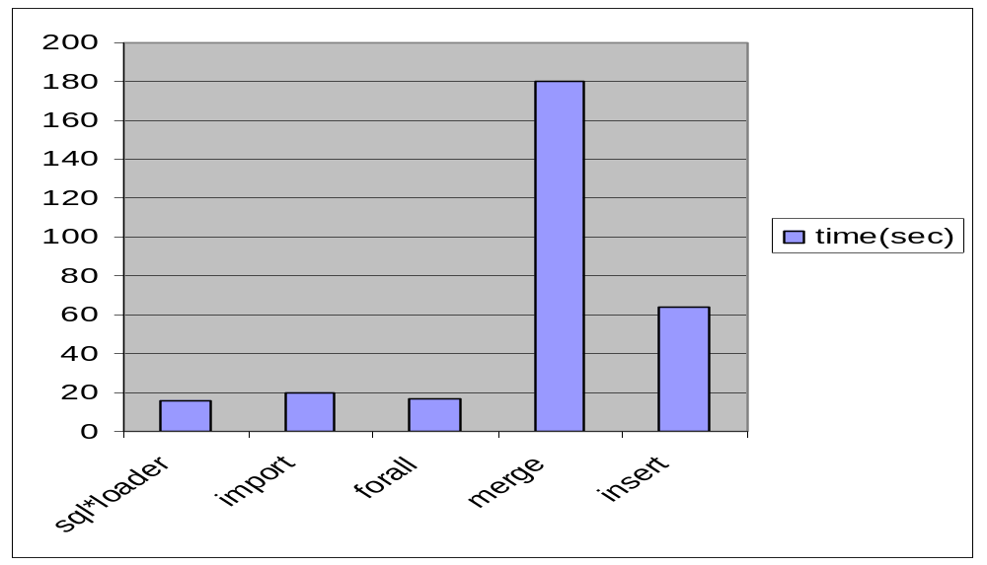
Comparison of various techniques

Slide 97
Insert operation
TABLE IN
TABLE OUT
Region | sales
North | 10
South | 20
North | 25
East | 5
west | 10
south | 10
Region | sales
North | 35
South | 30
East | 5
west | 10
F
Insert into OUT
Select * from (“F” (select * from IN)

Slide 98
Use only one “query block” ,if possible
Select Distinct * from sailors ,young_sailors Y
Where S.sname=Y.sname
Select Distinct * from sailors S where S.sname IN (select Y.sname from young_sailors Y )
=

Slide 99
Use only one “query block” ,if possible
(Not always possible!!!)
Select Distinct * from sailors S where S.sname IN (select Distinct Y.sname from young_sailors Y )
Select Distinct * from sailors ,young_sailors Y
Where S.sname=Y.sname
=

Slide 100
Steps in Query Tuning
Step1: Find the statements which consume most resources
Step2: Tune these statements so that they use less resources

Slide 101

Timing on
Use the timing on command to find query time
Sql>Set timing on
Every Sql query you execute is followed by statistics.
Elapsed Time :00:00:00:42

Slide 102

What’s slowing your query down?
Complexity of the queries
Processing speed
Hardware configuration

Slide 103
SQL Query Tuning
Use distinct clause only when there are duplicates,other wise do not …!!!
Distinct creates lots of work load
Select * potentially hurts query performance

Slide 104
Union operation
Merging result data from two or more queries
Heavy work load for SQL
Slows down your query
Use only when it is inevitable

Slide 105
UNION example
Select c1,c2 from table1
Where c1=some_value
UNION
Select c1,c2 from table1
Where c2=some_value
Select c1,c2 from table1
Where c1=some_value
OR c2= some_value

Slide 106

TOP Clause
Select Top 10 name,roll_no from MSC_Rank
Select Top 10 Percent name,roll_no from MSC_Rank

Slide 107
Sub string
Avoid using substring function
    Use ,
    cname LIKE “b%”
    Instead of using SUBSTRING(cname,1,1)= ‘b’

Slide 108
LIKE Clause
Try to use one or more leading character in the clause,if at all possible
For e.g..,
Use ,
LIKE ‘b%’
Not
LIKE ’%b’

Slide 109

FROM Clause
Assume that Customer_account table with100,000 clients, country table with 50 country_id (links the two tables)
  Consider the query that lists customers and countries,
Select c.country,a.name
From customer_account A, country C
Where A.country_id = c.country_id
Order by country, name

Slide 110
The query should be rewritten as,
Select c.Country,a.Name
From country C , customer_account A
Where A.Country_id = c.Country_id
Order by country, name
List tables in ascending order when you use from clause

Slide 111
NOT operator
Operators <>,!=,^=
Use = as much as possible and <> as least as possible
Select * from VOTERS
Where NOT (state_id >100)
Select * from VOTERS
Where state_id<=100

Slide 112
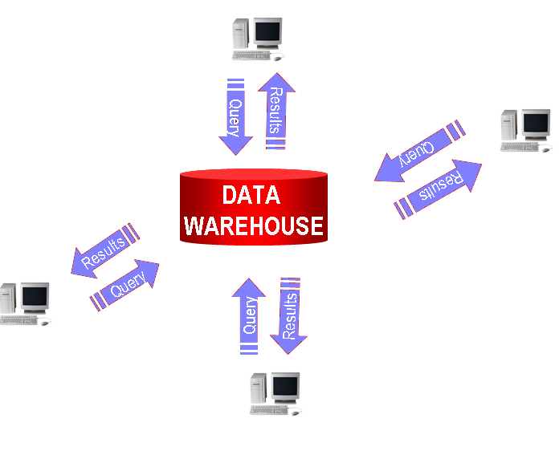
Ordinary Query Request

Slide 113
RPC (Remote Procedure Calls)
Ordinary Query requests take more time
RPC reduces Network traffic
Use Stored procedures

Slide 114
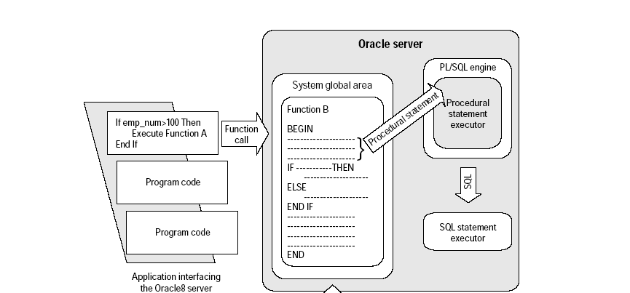
Simple procedure execution
A

Slide 115
Parallel Query processing
DATABASE
QUERY RESULT
DATA

Slide 116
Why parallel query processing ?
Multiple process can work together
ORACLE Server processes queries more quickly

Slide 117
Delete
Do not use DELETE ,if all rows are needed to be deleted
Use Truncate table command
Be careful when you use truncate

Slide 118
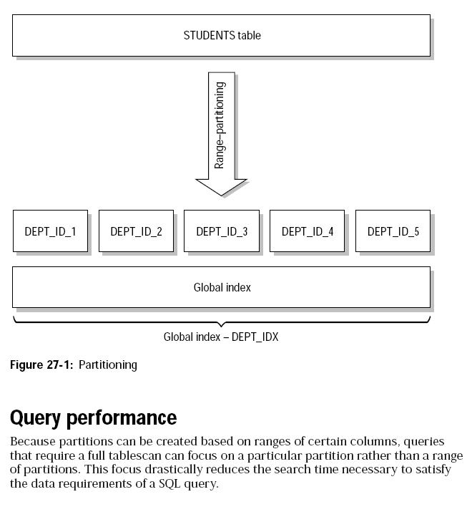
Partitioning

Slide 119
Query for U !!!
Select Name, roll no from MSC_rank where cgpa >8 And cgpa<=10
TUNE

Slide 120
It’s Simple
Select Name, roll no from MSC_rank where cgpa >8

Slide 121
Tune….Tune…..!!!
ORACLE 8i for Dummies IDG BOOKS
MSDN
WWW.SQL-SERVER-PERFORMANCE.COM

